Slide 1
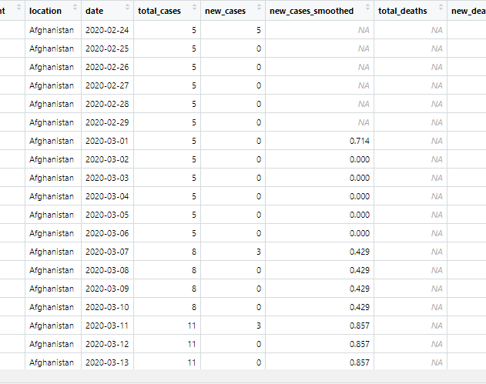
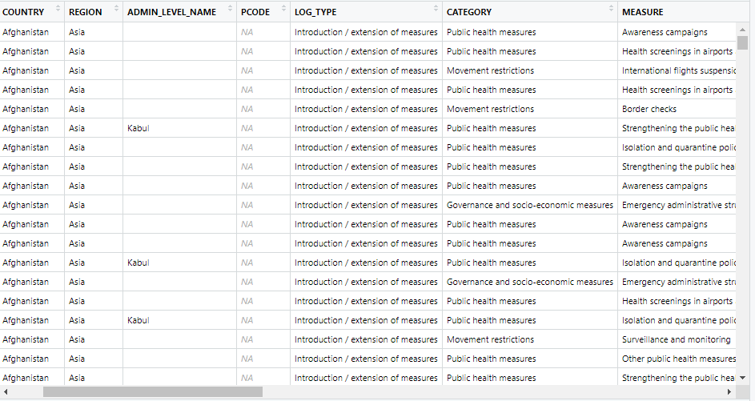
DataViz Purpose
Understand Covid
Trends across region
Trends over time
Effect of various events
Understand government measures
Effectiveness
When they were used

Slide 2
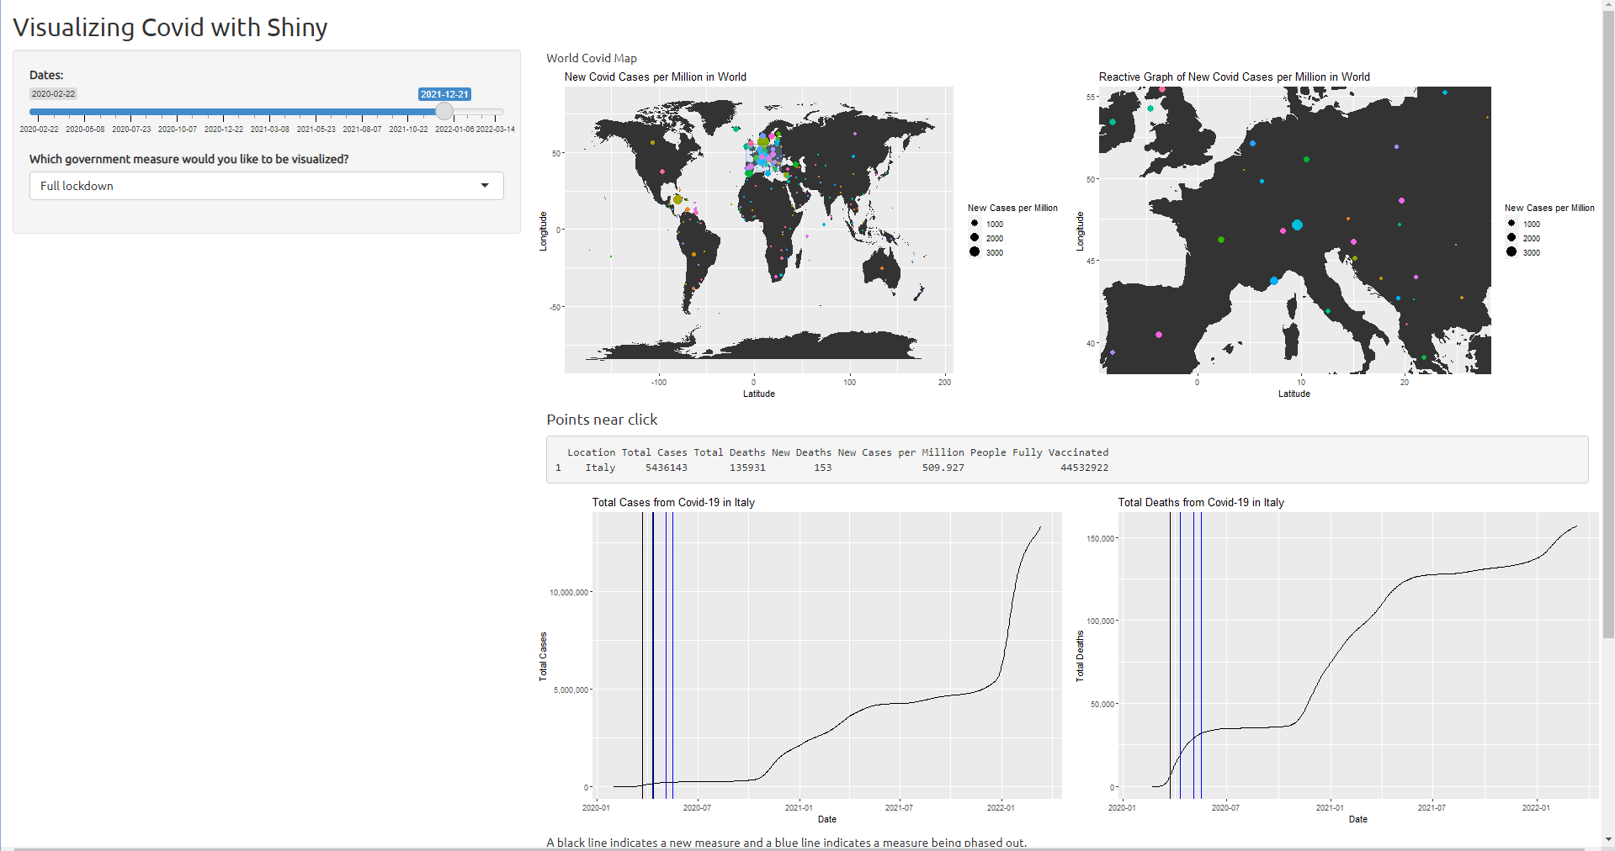
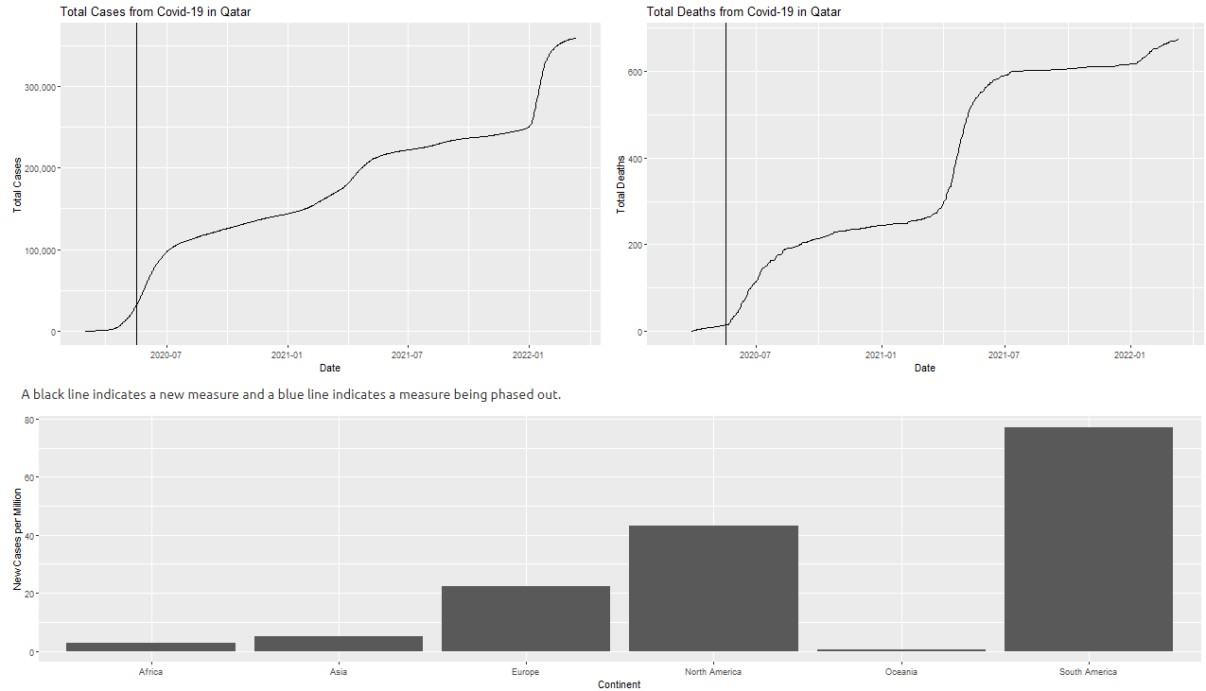
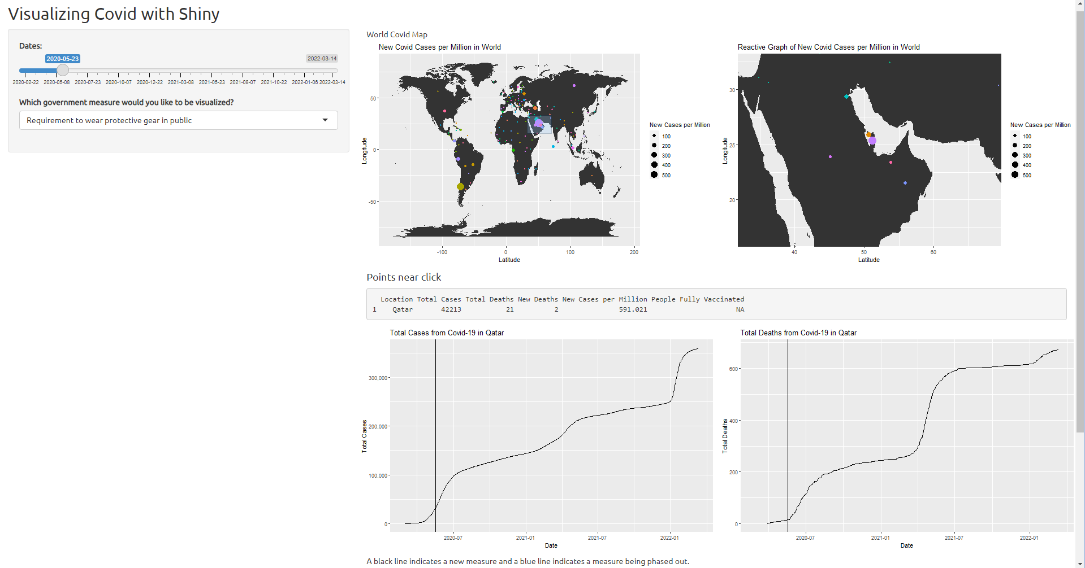
Questions
How did covid trend differently in different places of the world?
What government measures were used and were they effective?
How did cultural events affect covid-19?

Slide 3
Insights
Covid was sinusoidal in most areas
Super spreader events were noticeable
August 14th concert in UK
Countries and continents varied a lot
Government measures were sparse
Typically employed in first wave
Rarely employed during other waves
Vaccines? Pandemic fatigue? Unrest?
Typically effective
Difficult to determine real effectiveness

